Slide 1
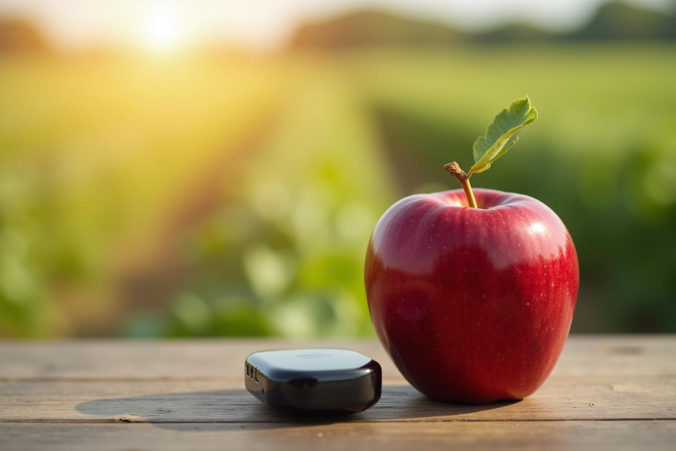
Camera and AI Classifier for Apple Grading
Enhancing defect and ripeness assessment in apples

Slide 2
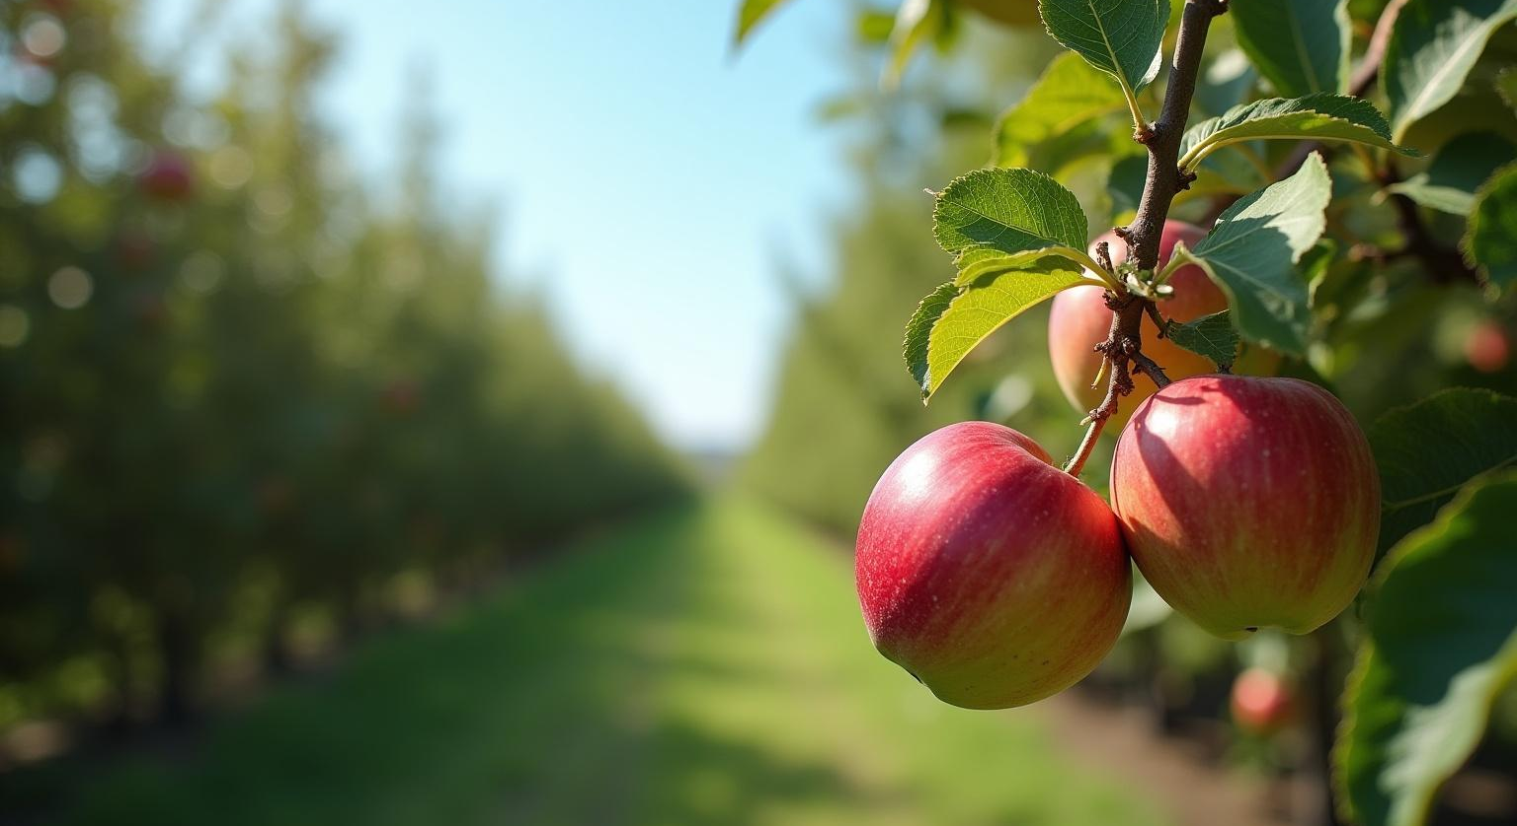
Introduction
The application of AI in agriculture is revolutionizing how we assess fruit quality. This presentation focuses on the use of camera systems combined with AI classifiers to grade apples based on defects and ripeness. By leveraging technology, we can achieve greater accuracy and efficiency in fruit grading processes.

Slide 3
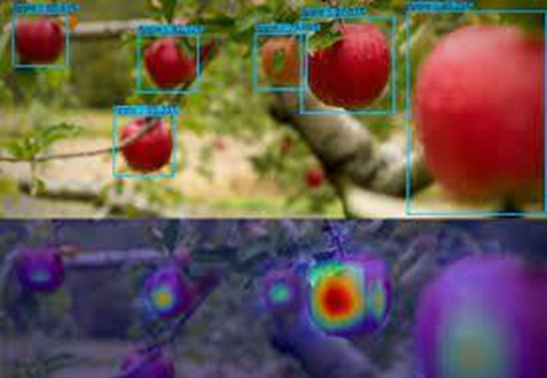
Post harvest losses due to improper sorting of apples.
Problem Statement – Post harvest losses due to improper sorting
of apples.
Solution - Ai + Camera Apple classifier and detection

Slide 4
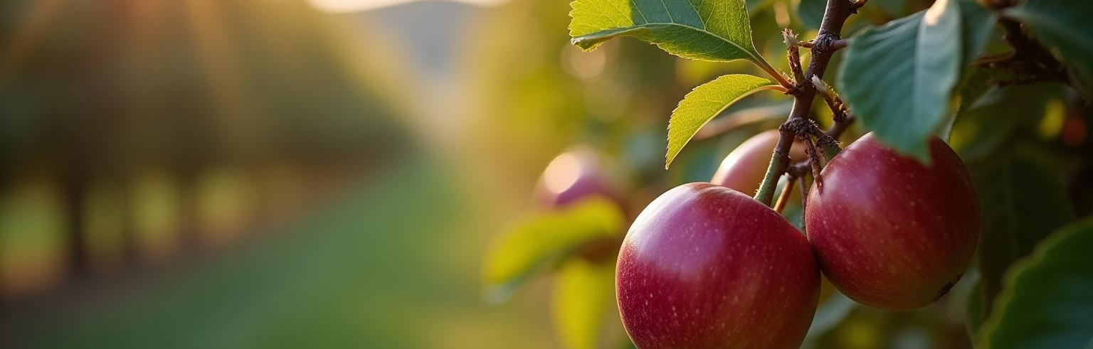
01
Introduction to AI in Agriculture

Slide 5
Overview of AI applications in farming
AI is transforming agriculture by optimizing processes, increasing yields, and reducing labor costs. Its ability to analyze vast amounts of data enables farmers to make informed decisions in real-time, improving productivity across various agricultural sectors.

Slide 6
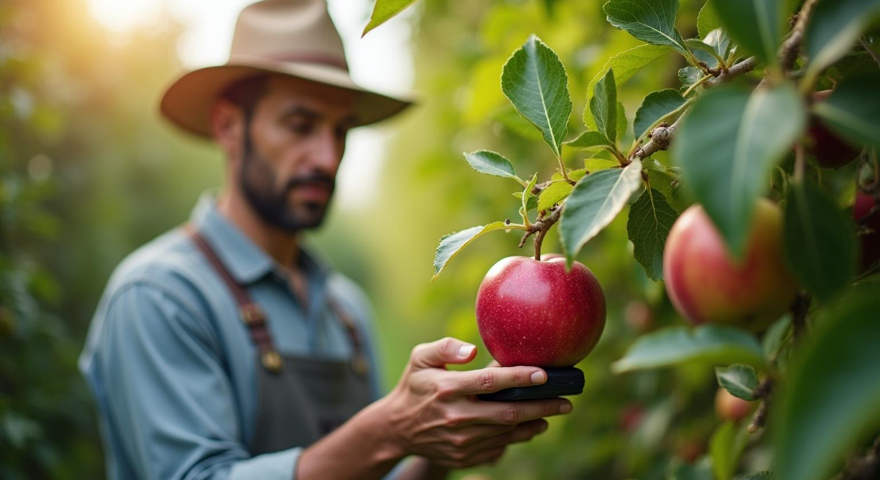
Benefits of using AI for grading
Adopting AI in grading resolutions facilitates swift analysis and enhances consistency in quality assessments. This technology minimizes human error, provides instant feedback, and ultimately leads to better quality control in produce grading.

Slide 7
Importance of accuracy in agricultural processes
Accuracy in grading directly impacts marketability and consumer satisfaction. Ensuring that each apple is accurately assessed for defects and ripeness aids in maintaining a high standard, enhancing the overall reputation of agricultural products.

Slide 8
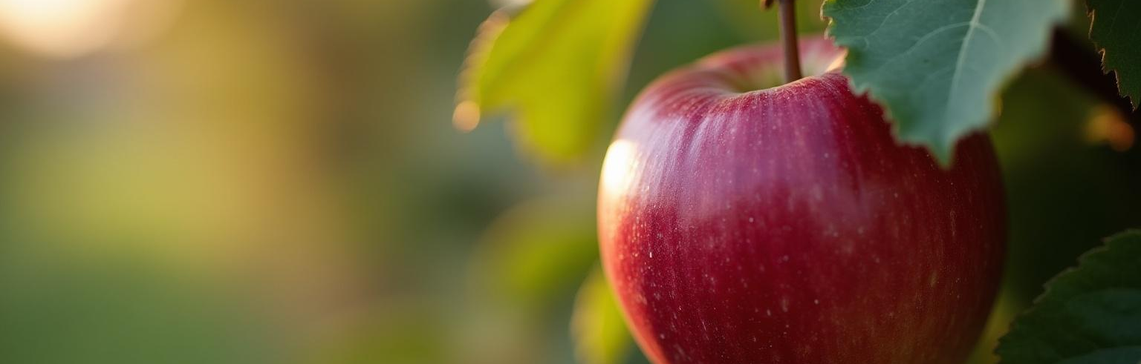
02
Camera Technology for Grading

Slide 9
Types of cameras used for defect detection
Various camera technologies, such as multispectral and hyperspectral cameras, are employed to detect subtle differences in apple skin and internal structure. These cameras capture detailed images that assist in identifying imperfections effectively.

Slide 10
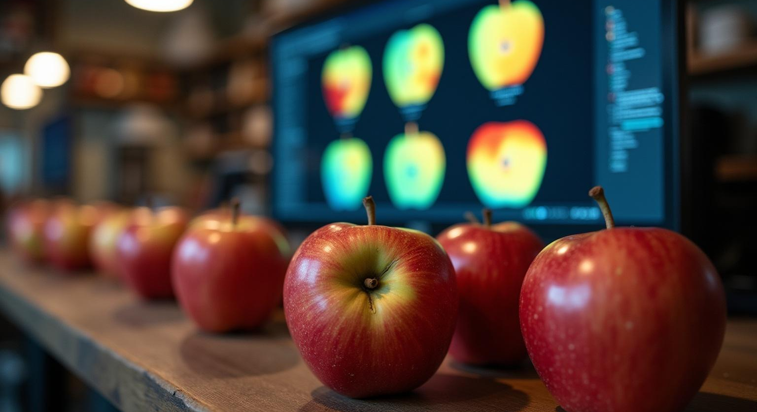
Image processing techniques
Advanced image processing techniques, including machine learning algorithms, are employed to analyze captured images for grading purposes. This enables the identification of defects such as bruises, blemishes, and color inconsistencies, ensuring precise assessments.

Slide 11
Real-time grading capabilities
Integrating camera systems with AI allows for real-time grading of apples as they move through packing lines. This capability helps in making immediate decisions regarding product quality, facilitating efficient sorting and packaging processes.

Slide 12
Real-time grading capabilities
Integrating camera systems with AI allows for real-time grading of apples as they move through packing lines. This capability helps in making immediate decisions regarding product quality, facilitating efficient sorting and packaging processes.

Slide 13
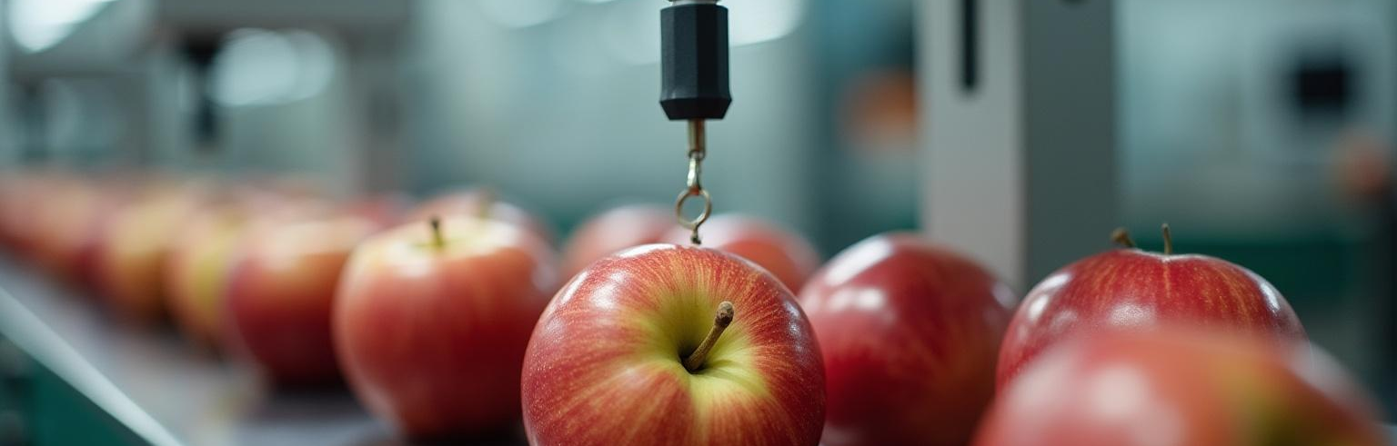
03
Classifying Apples by Defect and Ripeness

Slide 14
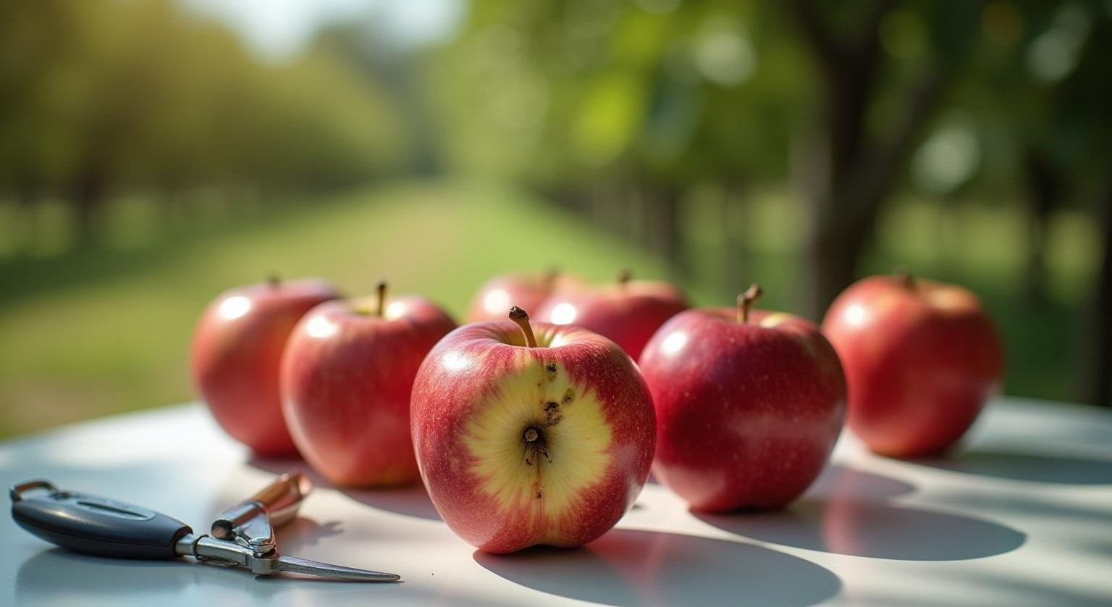
Standard defects in apple grading
Common defects in apples include bruises, color defects, rot, and physiological disorders. Identifying these imperfections is crucial for maintaining quality and ensuring consumer satisfaction. Understanding these defects helps in refining grading criteria and improving overall product appeal.

Slide 15
Methods for assessing ripeness
Ripeness assessment methods include color analysis, firmness testing, and sugar content evaluation. By employing these techniques, we can determine the optimal harvesting time and improve the quality of the apples offered in the market while enhancing shelf life.

Slide 16
AI algorithms for classification
AI algorithms such as convolutional neural networks (CNNs) and support vector machines (SVMs) are used to classify apples based on defect and ripeness criteria. These algorithms can learn from extensive datasets, improving their accuracy and efficiency in identifying quality variations in apple grading.

Slide 17

04
Data Visualization in AI Grading

Slide 18
Importance of data visualization
Data visualization plays a crucial role in interpreting complex data collected during grading processes. Effective visual representation aids stakeholders in quickly understanding grading outcomes, leading to informed decision-making and strategy development.

Slide 19
Example of bar charts for defect distribution
Bar charts provide a clear representation of defect distribution in graded apples. They enable stakeholders to identify the most prevalent defects, helping to develop targeted solutions for quality enhancement and minimize future occurrences.

Slide 20
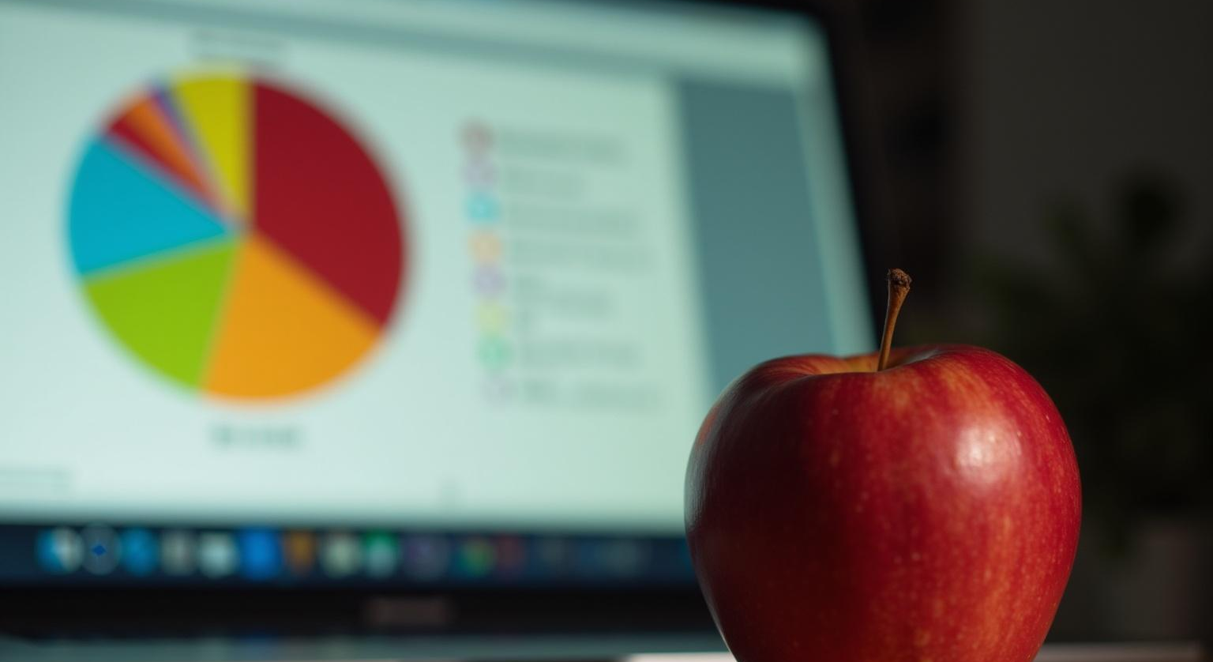
Example of pie charts for ripeness categories
Pie charts illustrate the proportion of apples across different ripeness categories. This visual approach simplifies the communication of ripeness data, allowing for a better understanding of available product quality and aiding in inventory management.

Slide 21
Conclusions
The integration of camera technology and AI for apple grading has the potential to revolutionize the agricultural sector. By ensuring precise grading based on defect and ripeness assessment, we can enhance quality control, improve marketability, and increase overall efficiency in the supply chain.

Slide 22
Thank you!
Do you have any questions?
+00 000 000 000

